Slide 1
Buffer SMA Rotation Framework

Slide 2
What We Tested - The Framework
WHEN to switch (Triggers)
WHAT to switch to (Selections)
Cap Utilization Threshold
Remaining Cap Threshold
Reference Asset Return
Time-Based Rebalance
Highest Remaining Cap (bullish)
Lowest Cap Utilization (defensive)
Most Recent Launch (neutral)
Over 400 simulations ran. Can expand to test other combinations, consider greeks, etc.

Slide 3
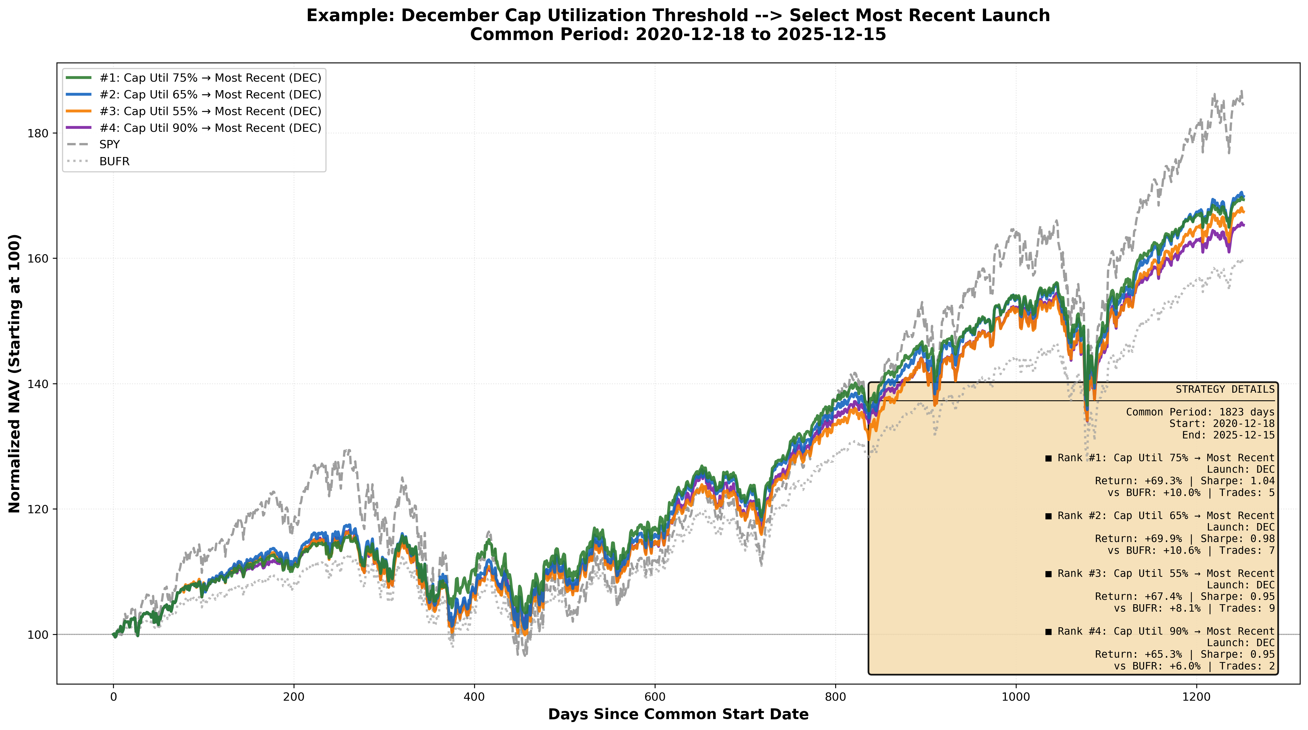
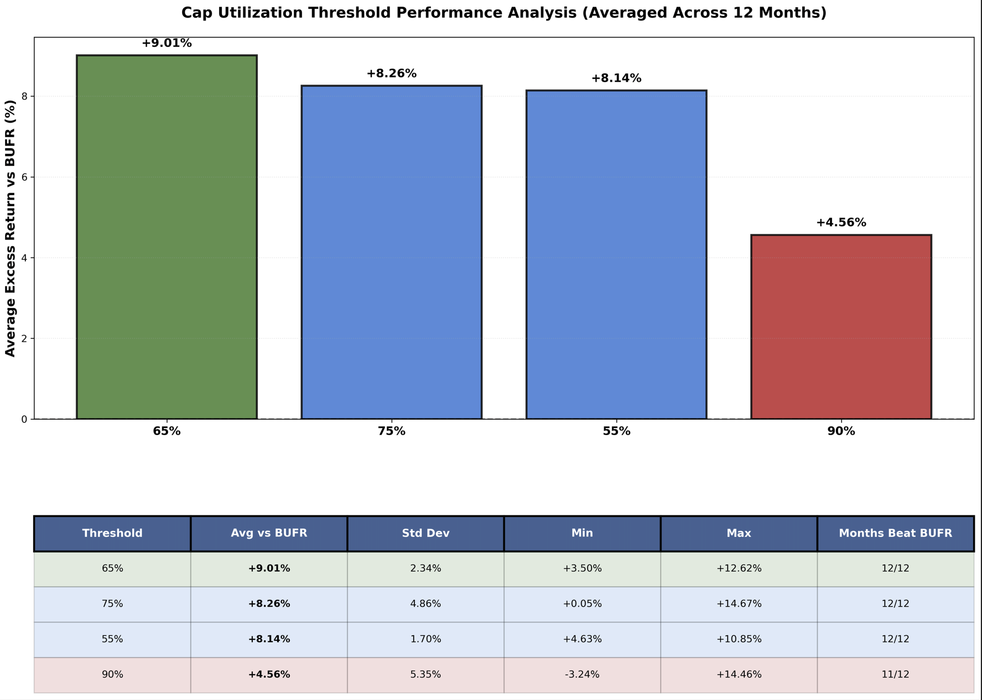
Existing Naïve 90% Cap Threshold Underperforms

Slide 4
Recommendation for further discussion

Slide 5
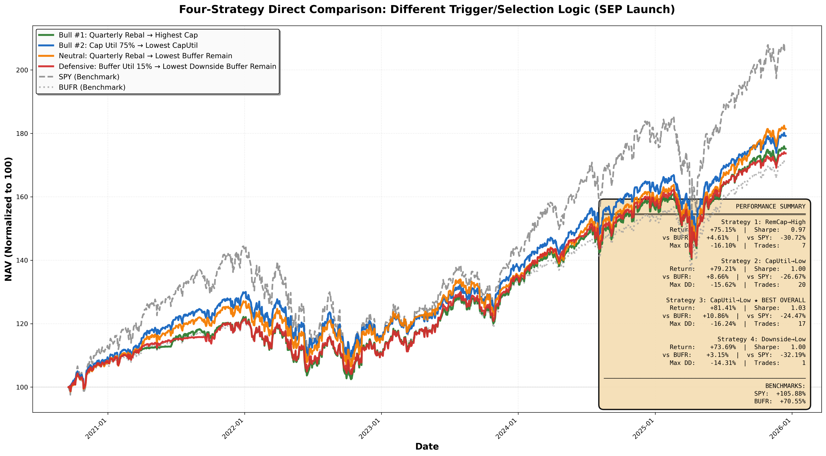
Outlook | Trigger | Selection | Threshold | Intuition
Neutral | Quarterly Rebalance | Lowest Remaining Buffer | n/a | Invest in funds in or at buffer zone
Defensive | Remaining Buffer | Lowest Downside Before Buffer | 15% | Invest in funds below ATM strike and in the buffer zone
Outlook | Trigger | Selection | Threshold | Intuition
Bullish | Quarterly Rebalance | Highest Remaining Cap | n/a | markets will continue rising and want to maximize upside capture.
Bullish | Cap Utilization Threshold | Lowest Cap Utilization | 65% | want to respond quickly to market moves

Slide 6
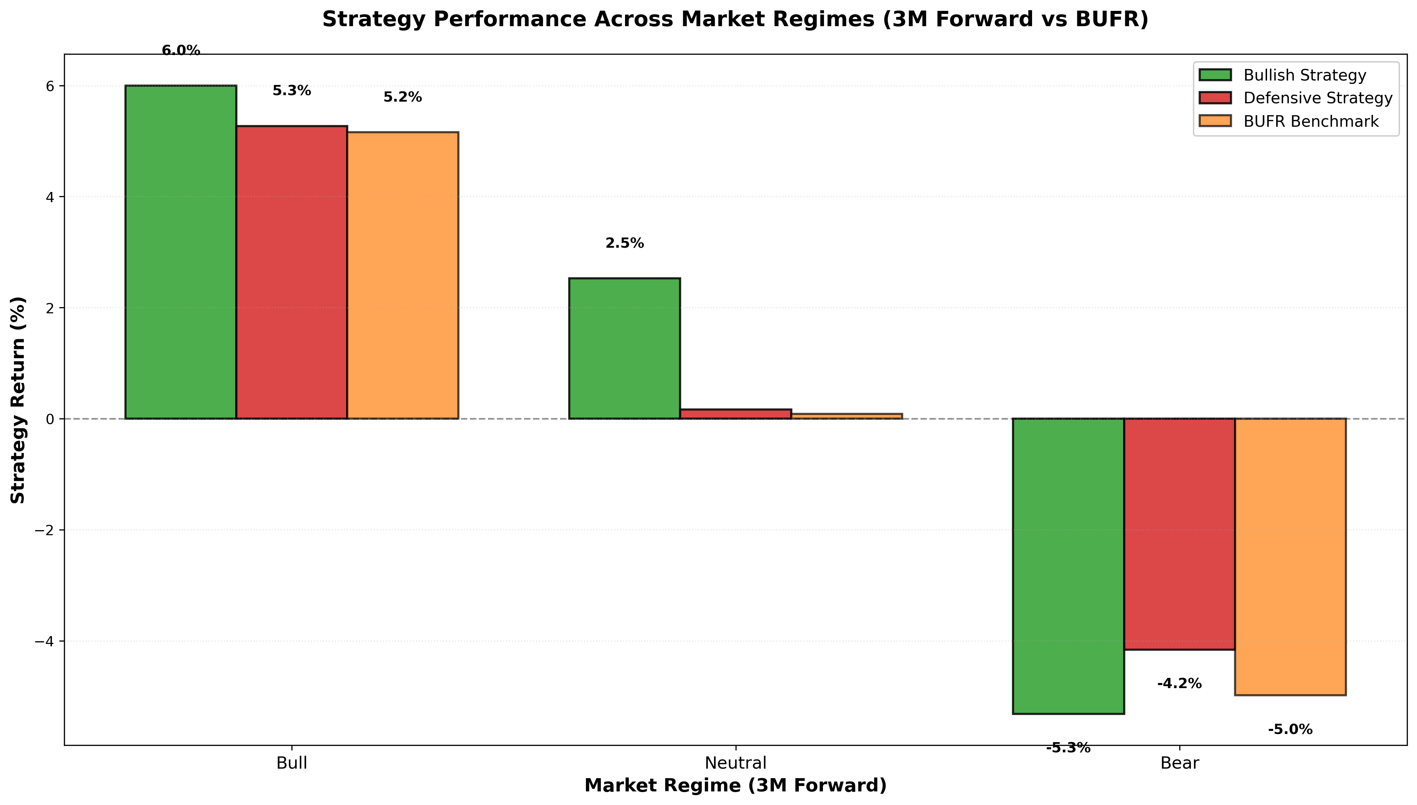
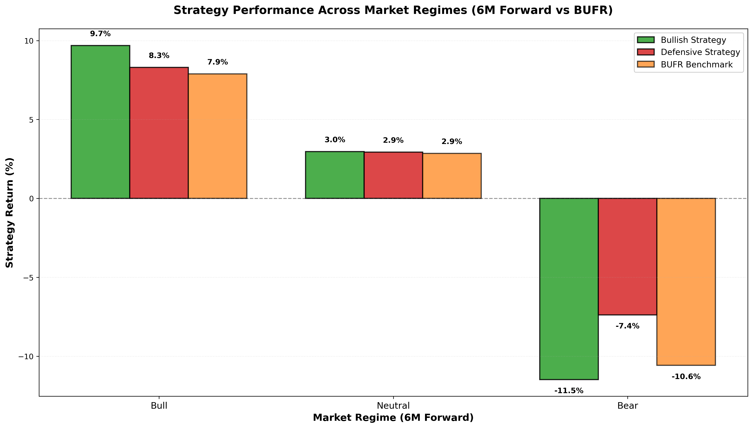
No Universal Solution (Regime Matters)
Assigned strategic intent to each trigger/selection combination (bullish/defensive/neutral)
→ Measured actual performance across historical market regimes
→ Validated whether strategies delivered as designed
Bullish strategies - those selecting funds with highest remaining cap - deliver exceptional returns in bull markets.
Defensive strategies - those selecting funds with lowest utilization and downside before buffer- show the opposite pattern.

